Slide 1
STEM
Edit and explore 3D Designs

Slide 2
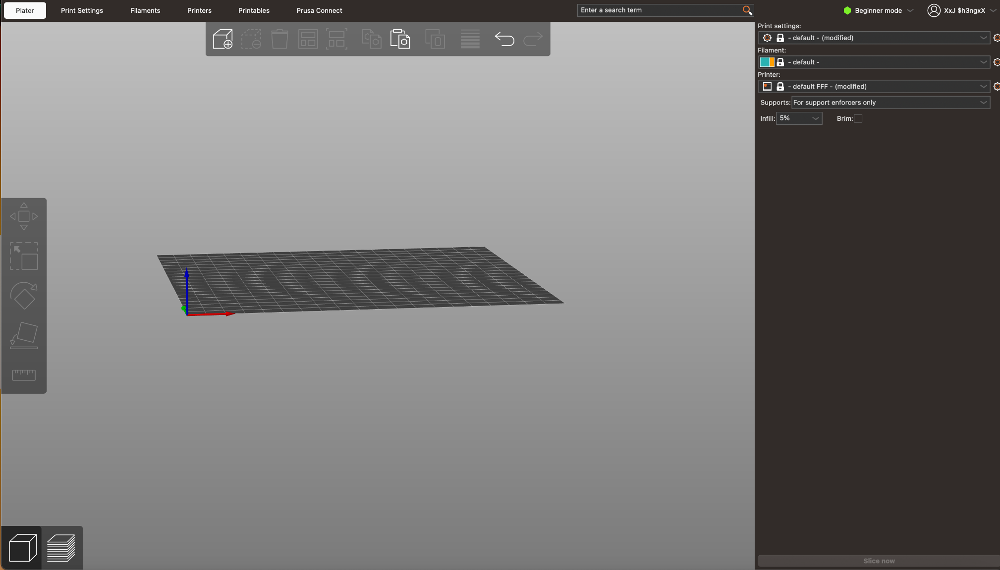
Prusa Slicer

Slide 3

Moving the Panel
Zoom in & out
Rotate the panel
Move the panel

Slide 4
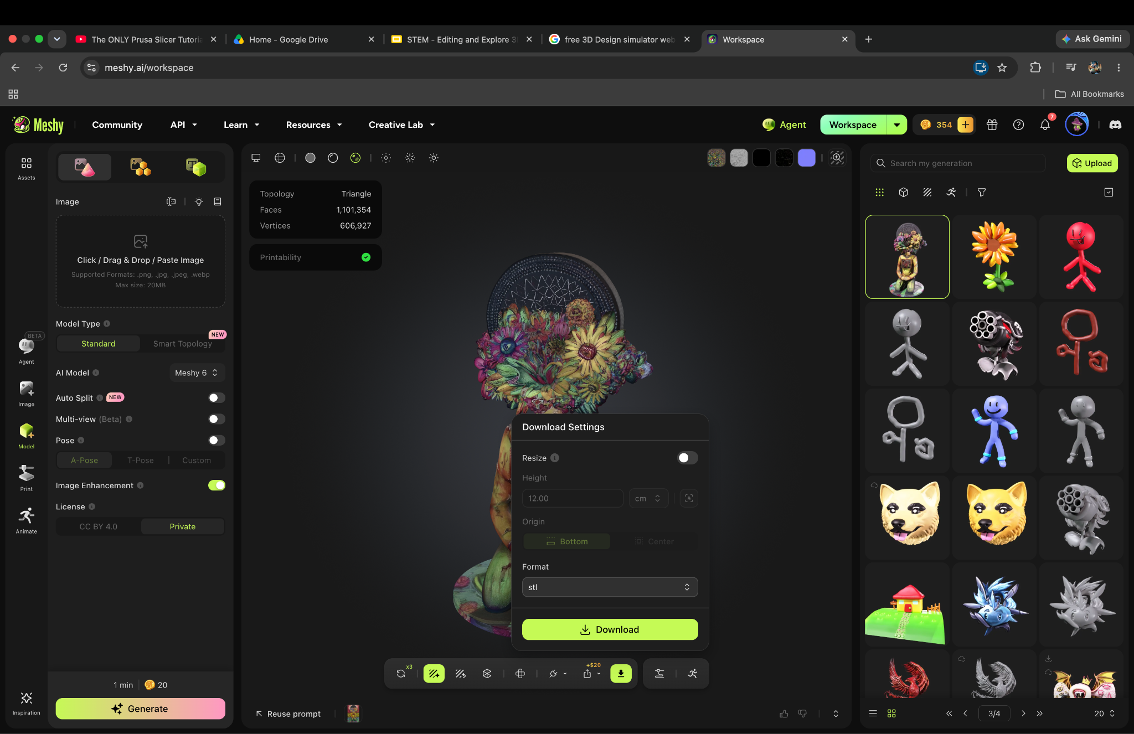
How to upload 3D Design to 3D Simulator?

Slide 5
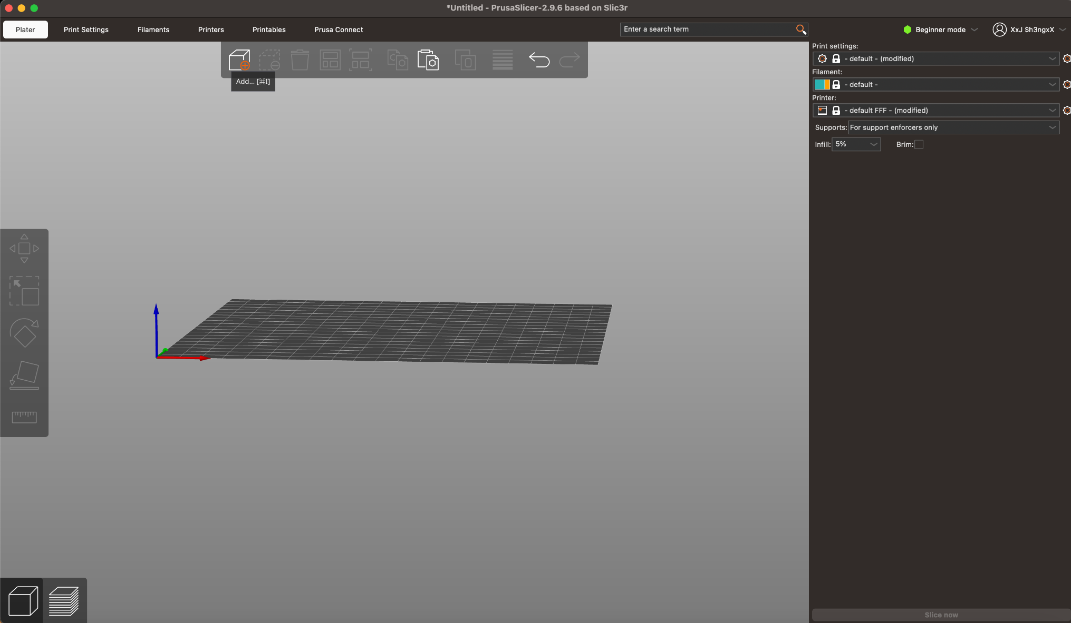
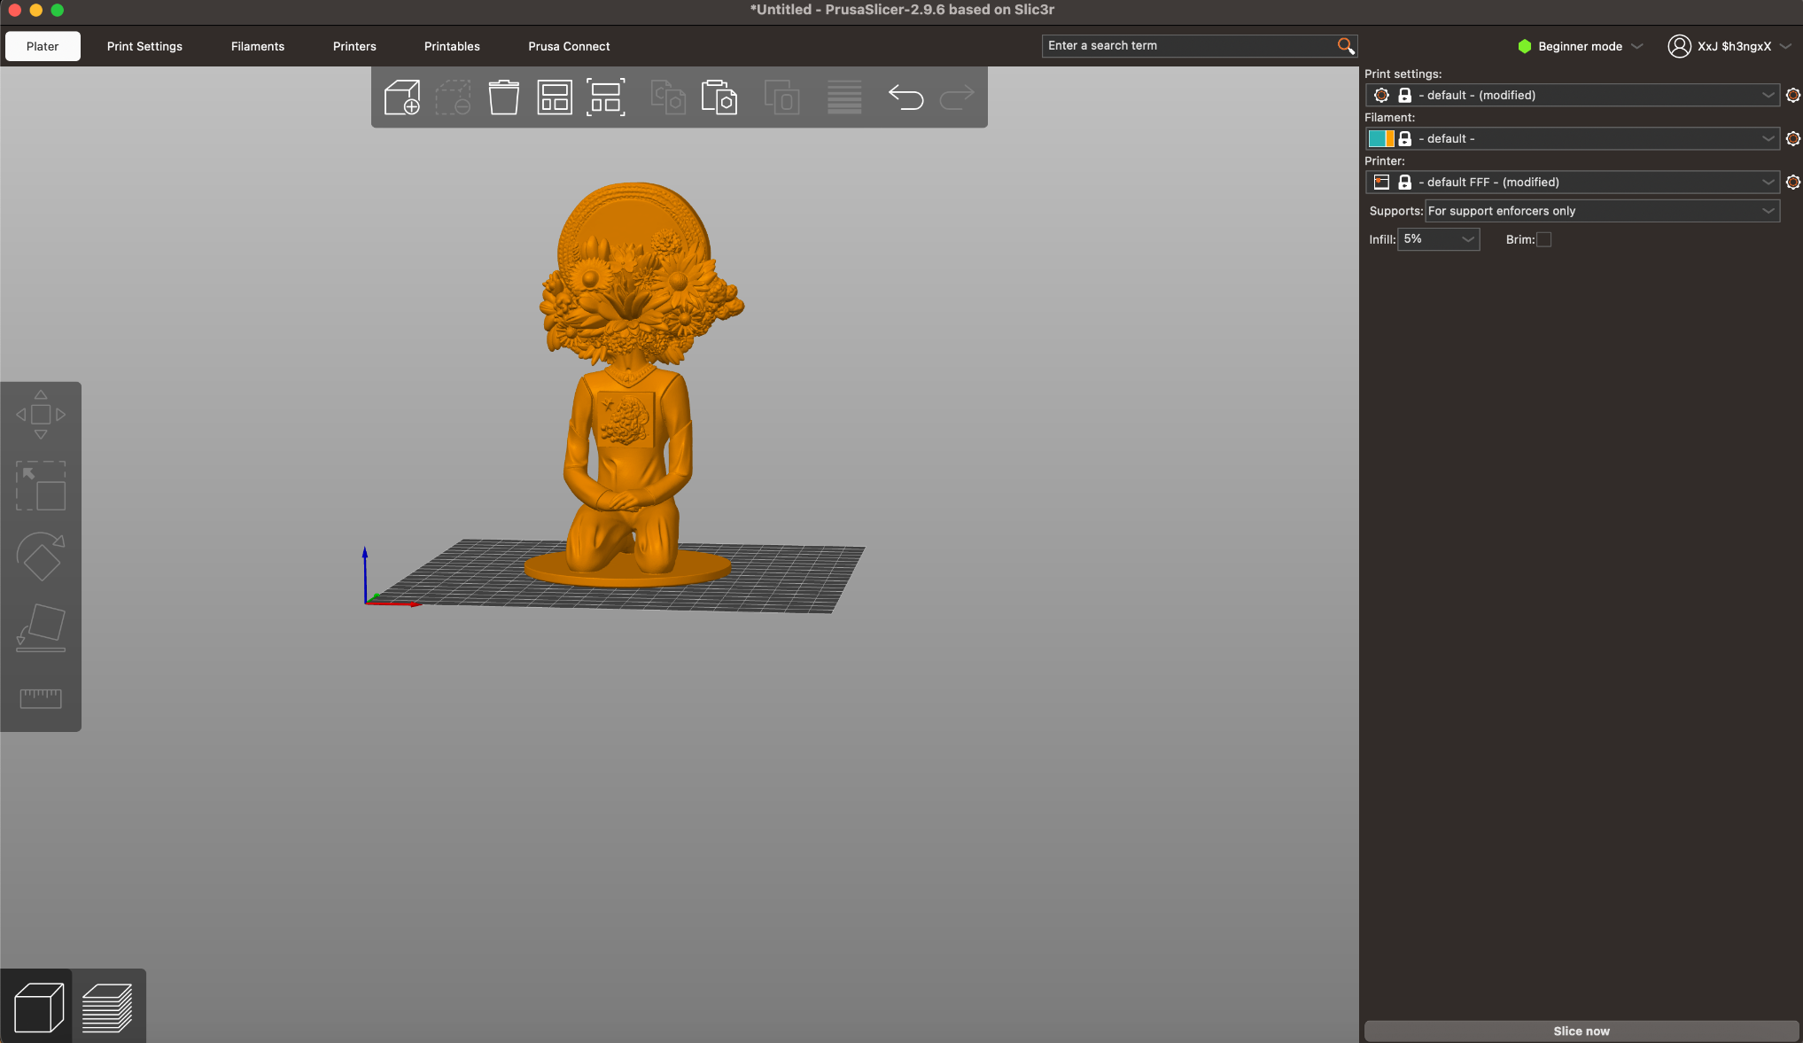
How to upload 3D Design to 3D Simulator?

Slide 6
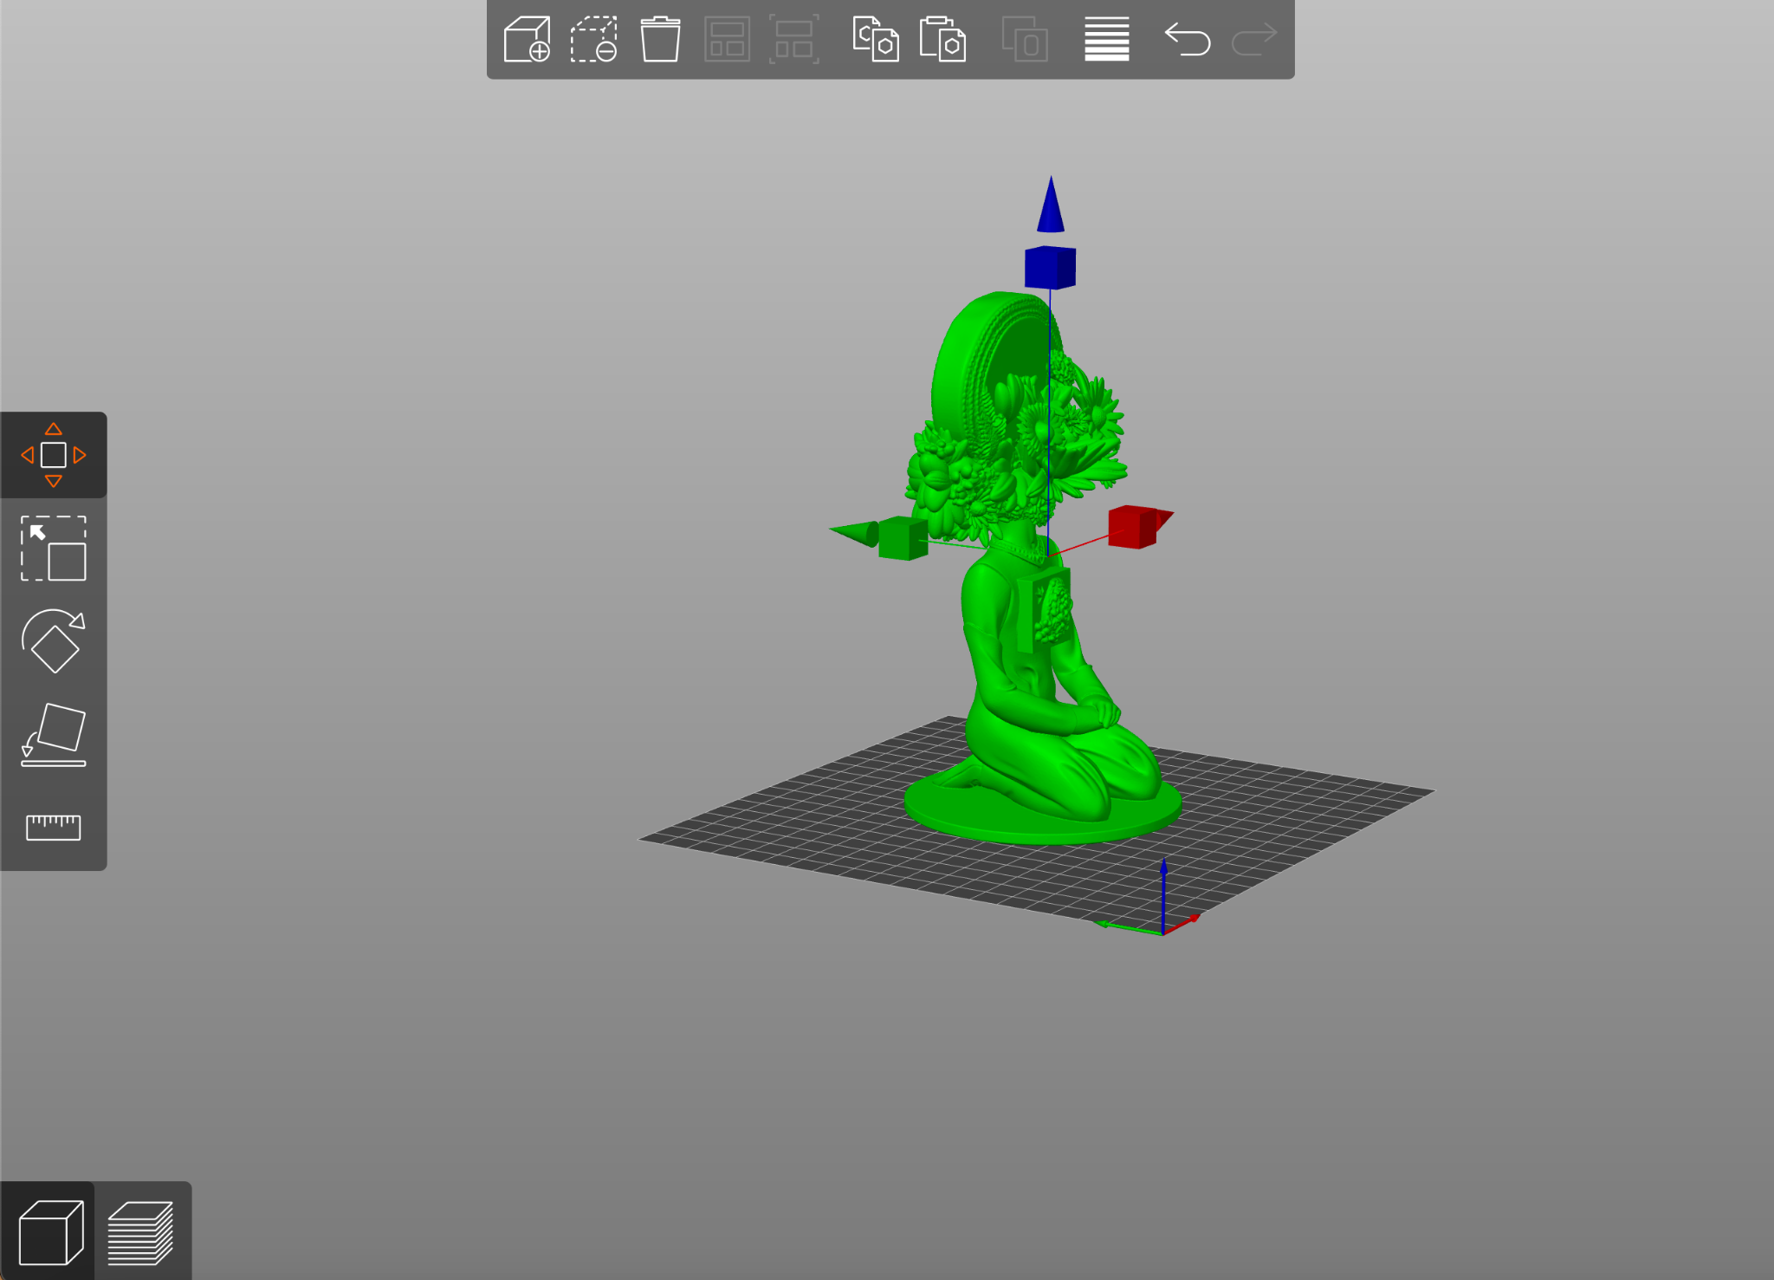
Moving your 3D Design

Slide 7
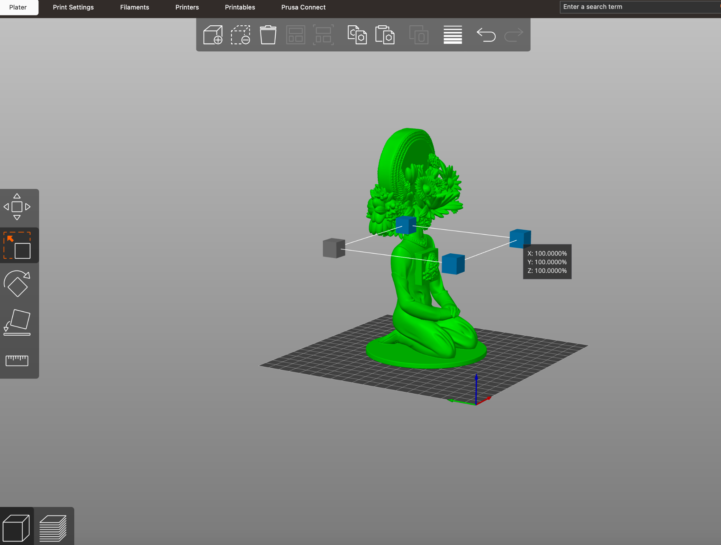
Scaling your 3D Design

Slide 8
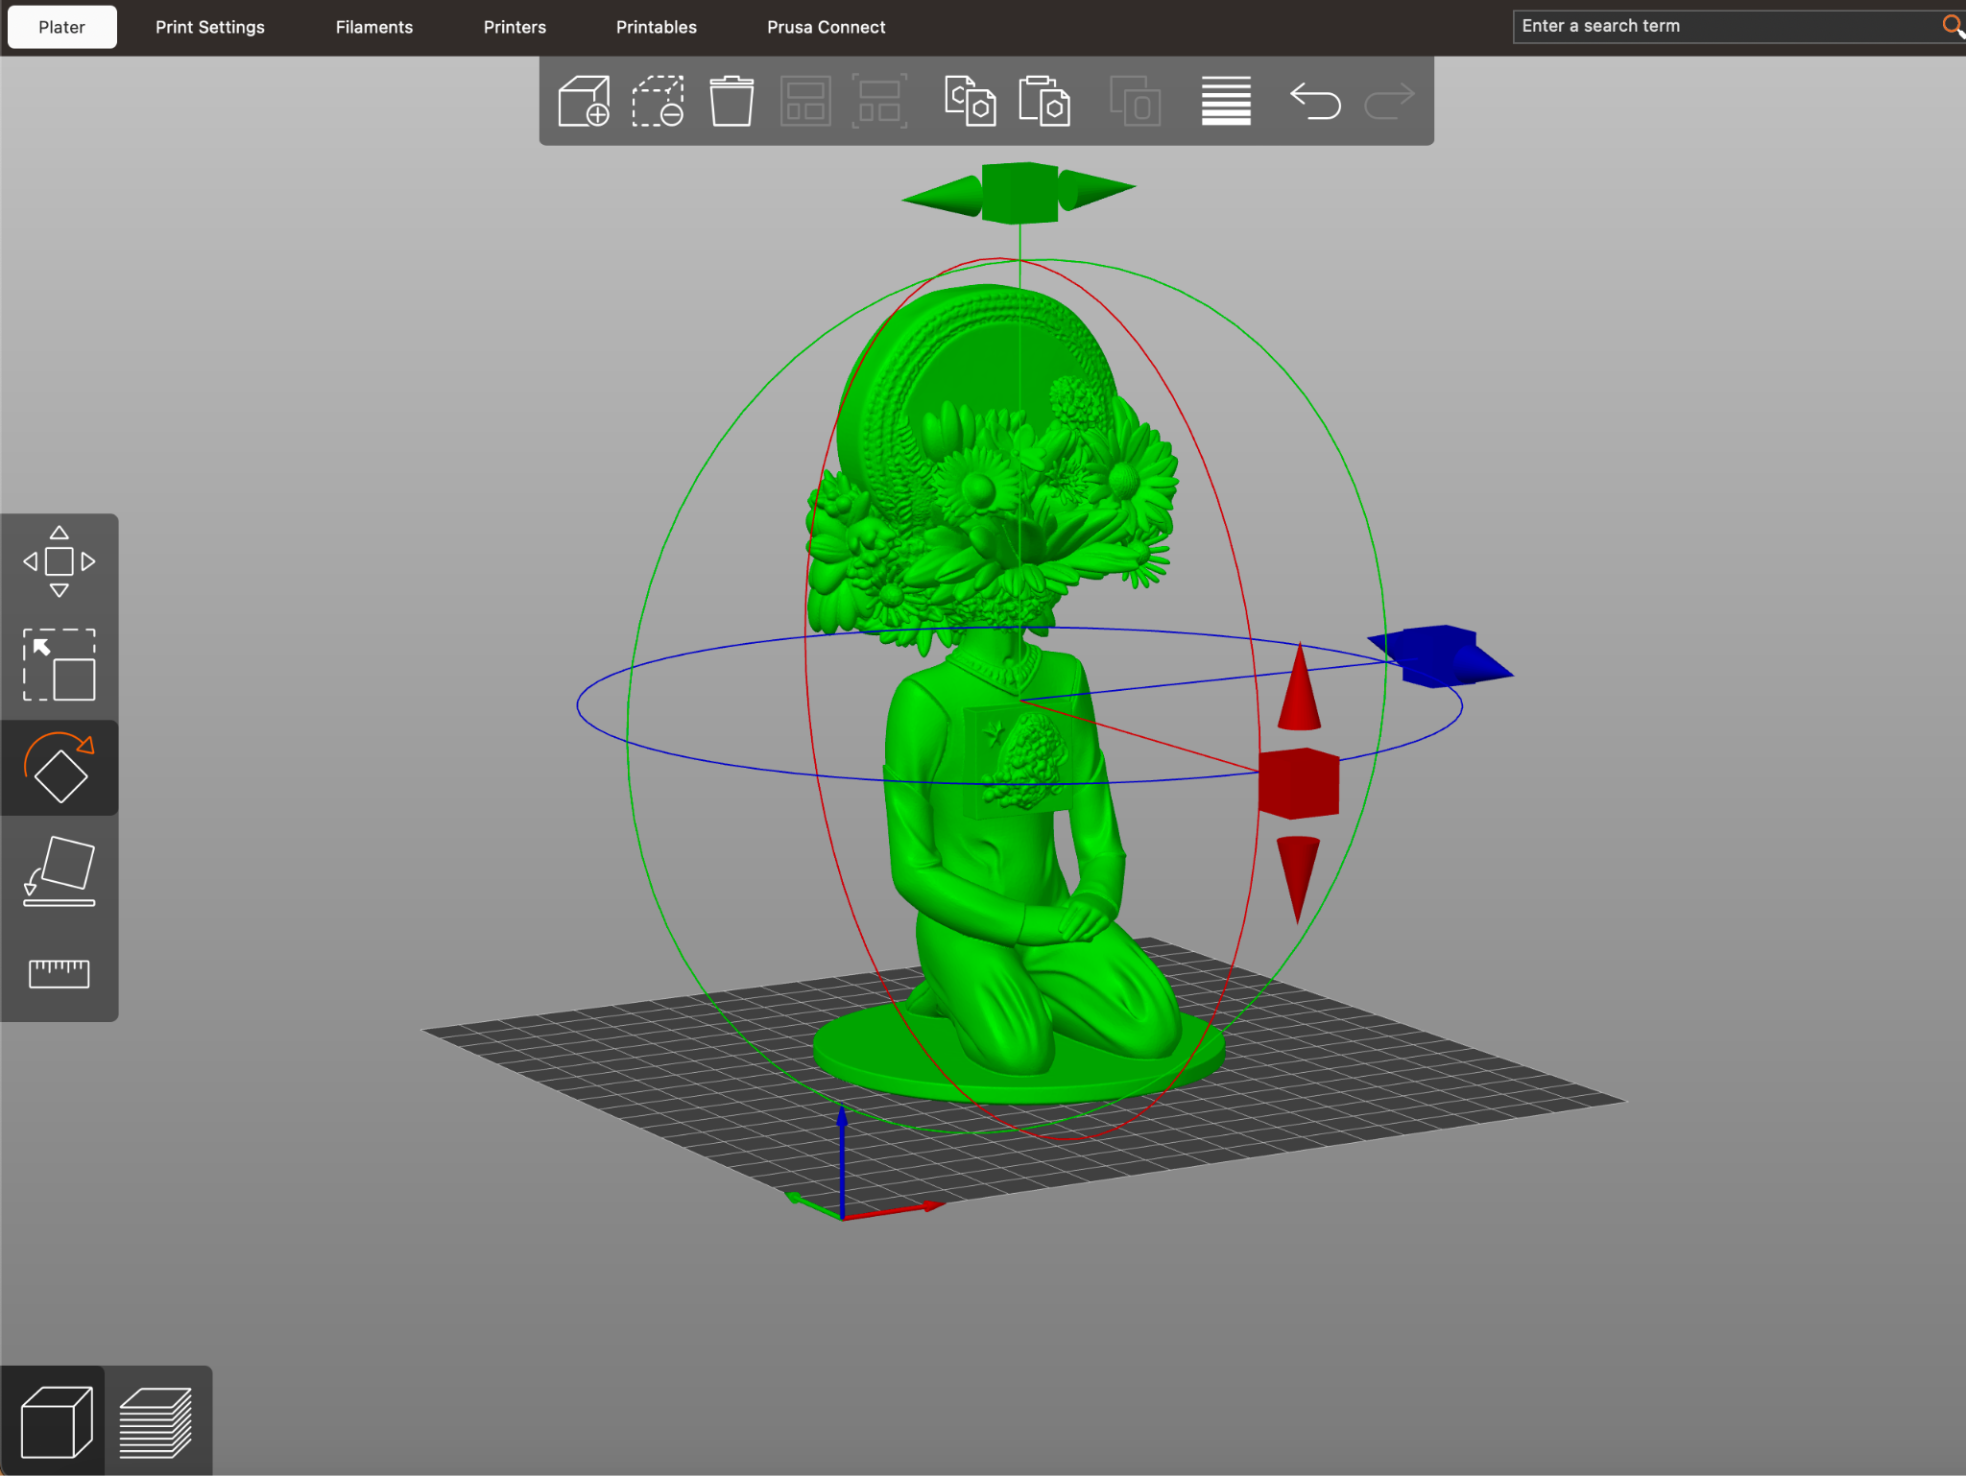
Rotating your 3D Design

Slide 9
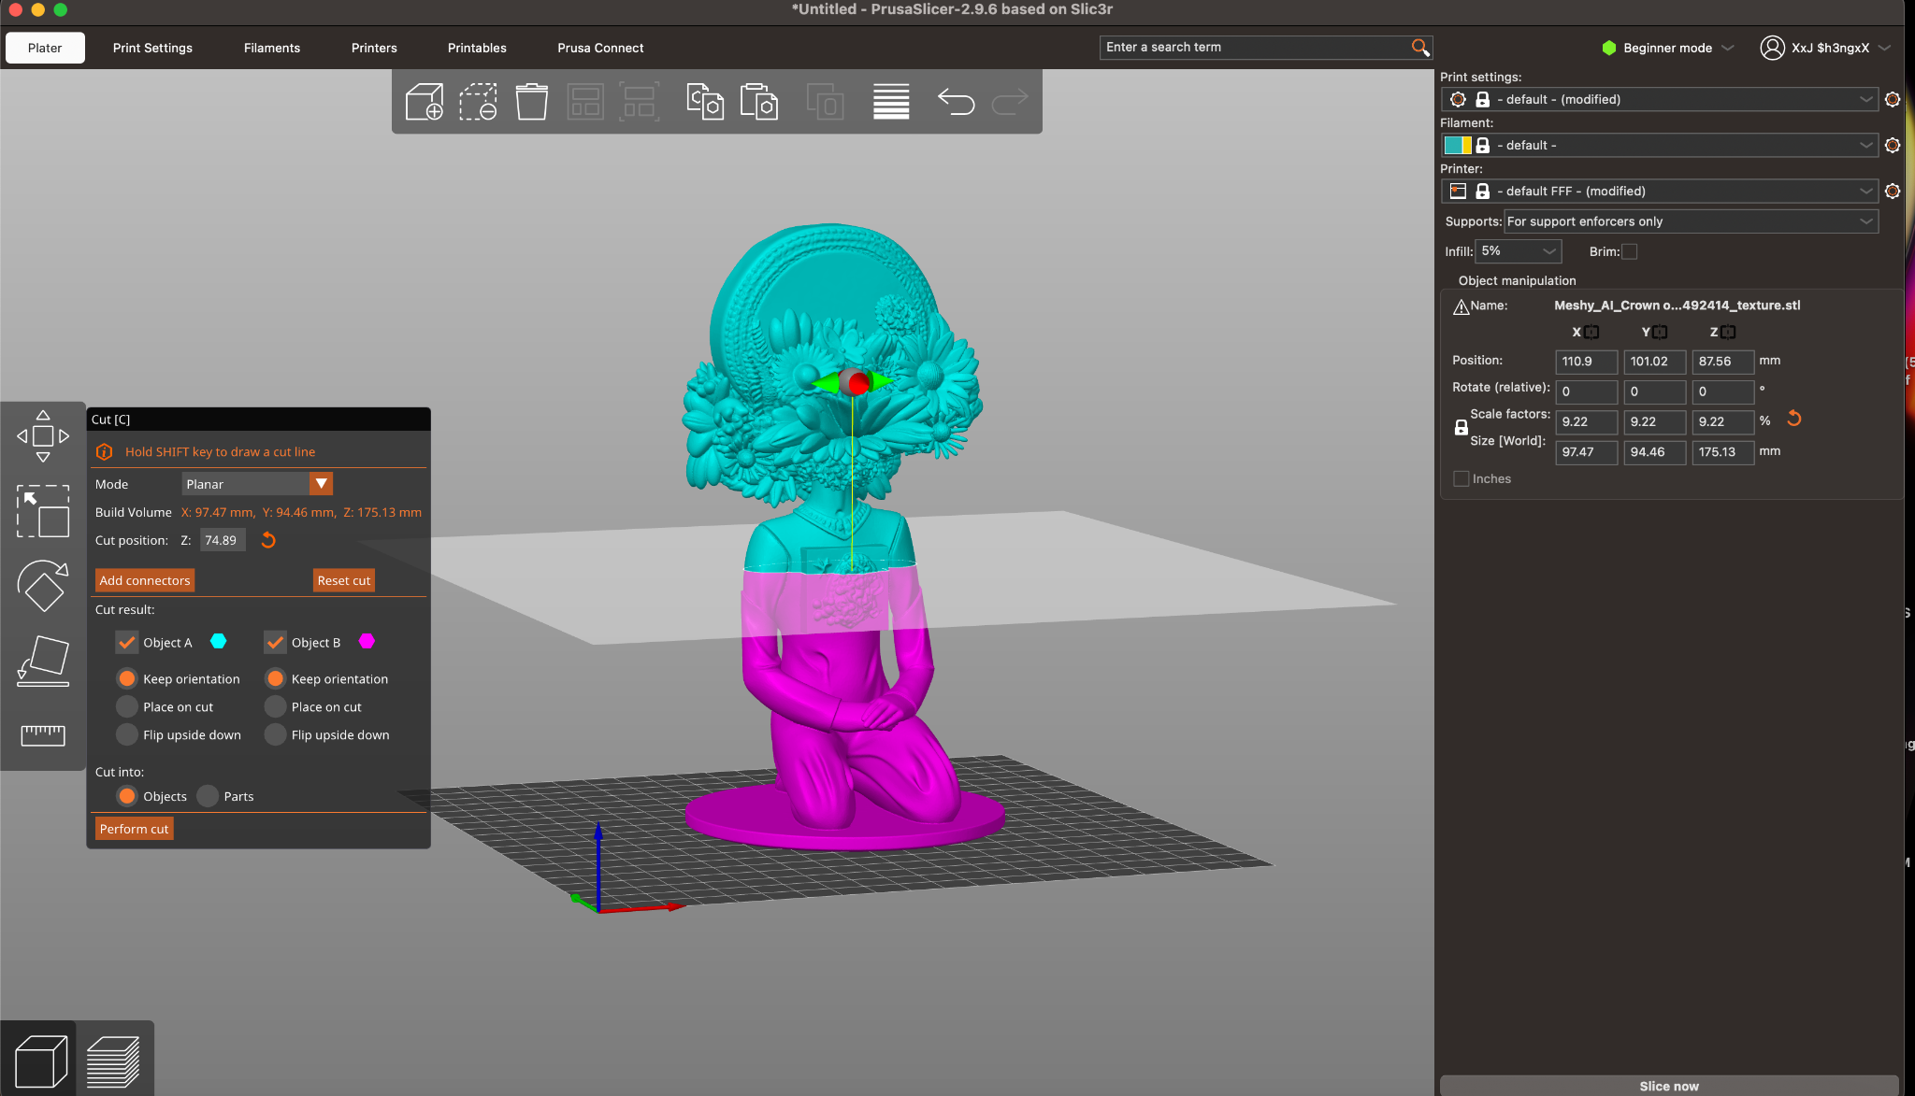
Cutting your 3D Design
Press “C” on keyboard first

Slide 10
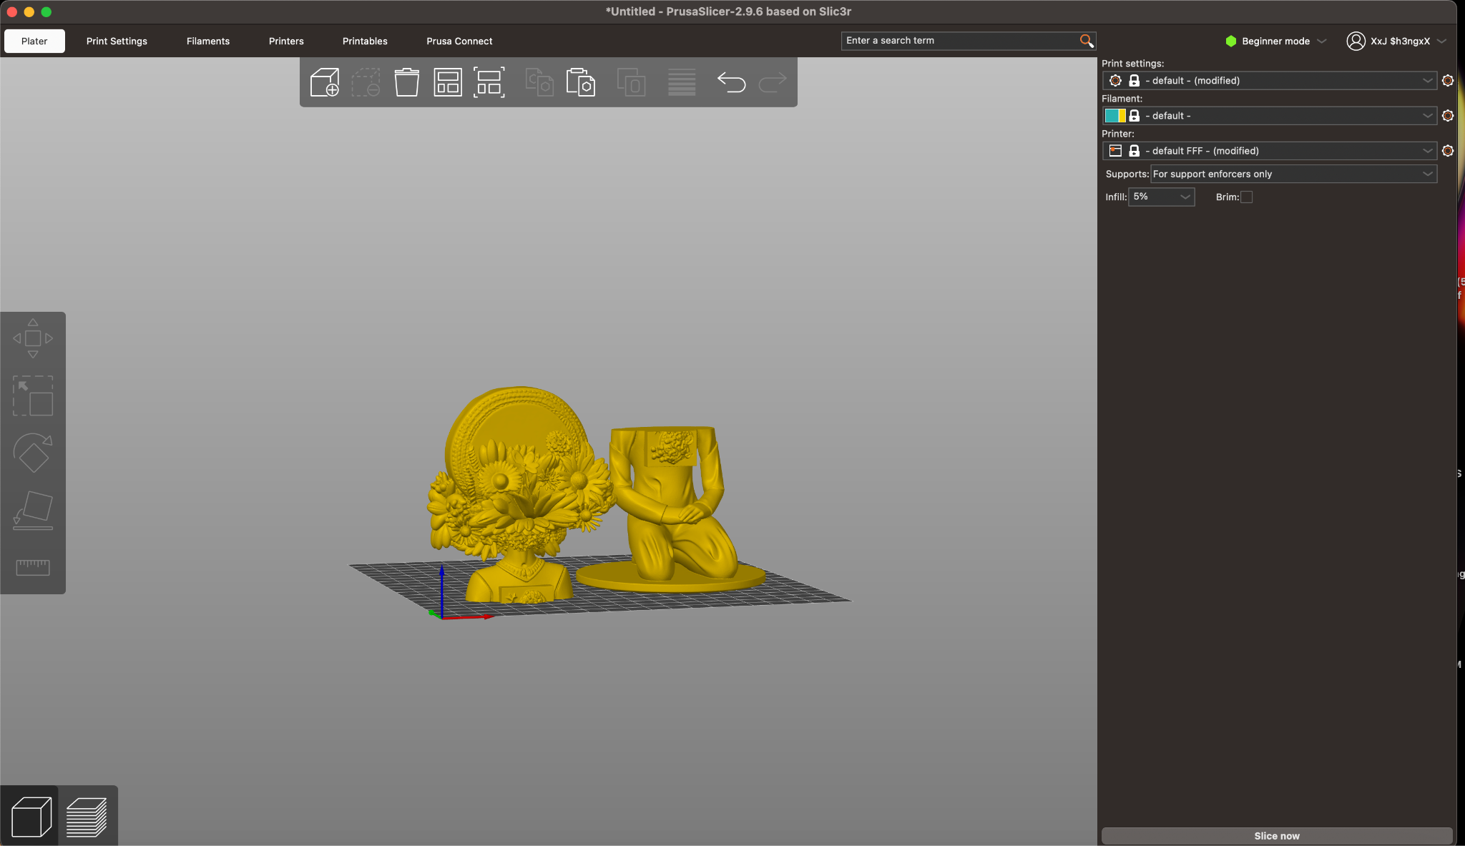
Cutting your 3D Design

